Slide 1
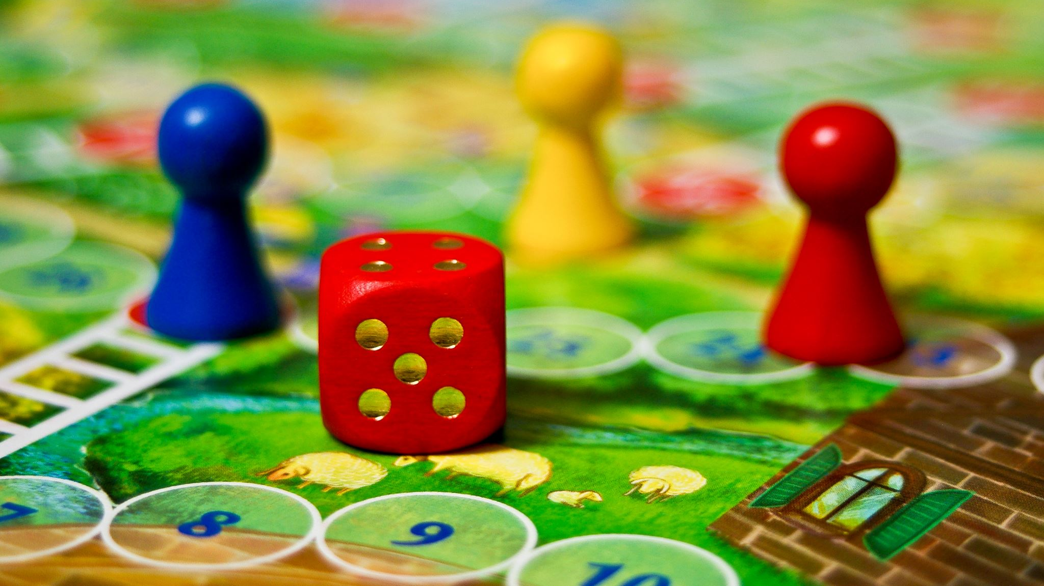
An AI-based Approach to Designing Board Games
Team #6, Board Gamers Ilao Michael, ilaom Bedi Hargun, bedih Dang Jeffrey, dangj12 Ada Jonah, karaatan Mai Tianzheng, mait6

Slide 2

Vision and Goals
What our project goals are NOT
A table-top simulator
An AI research project to create the best AI Player
An interactable system to play against the AI
What our project goals ARE
Create an extensible framework that can easily add new mechanics
Explore the very large observation space. (currently 850x40 ~ 2^(850*40) combinations)
Help the "An Age Contrived" Game designers balance their game
Notes:
- The framework accepts new game mechanics incrementally so we can validate new features by adding/removing and checking the results on the data visualizer
Mention Sycthe how the game was played hundreds of times to help balance and that was a major selling point of the game, but since the observation is also large, some non-playful strategies were found after the game was released. Our game An Age Contrived is more complex and even bigger than Sythe so we need this project to explore this large space.
Our final goal is not only the results we can see from the data visualizer and how we can help balance the board game, but also the framework itself and how it could be implemented with other games or simulations

Slide 3
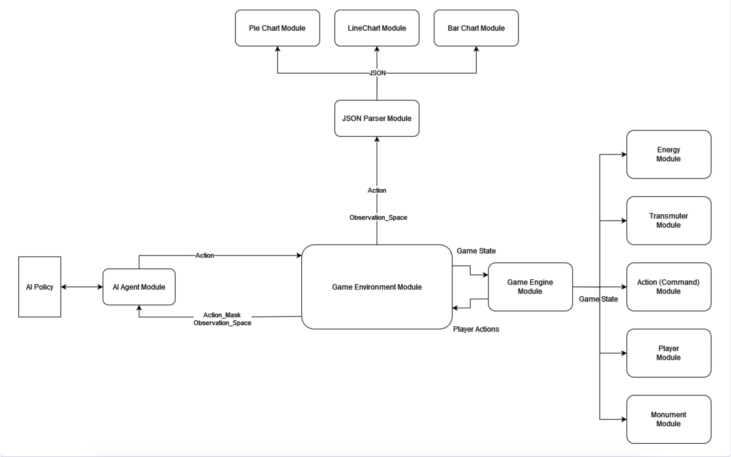
Architecture & Framework

Slide 4

Demo

Slide 5

Verification and Validation
Use various methods to verify the success of the AI agents and the system structure on the prototyping of the board game
Game rulebook comparison
Game designer validation
Data visualizer feedback and data analysis
Able to see frequencies of the certain moves
Make critical analysis on patterns in the data
Changing game parameters
See how the data changes with changes to game rule
Applying the system on other board games
Notes:
-Various methods to verify the success of the AI agents and the system structure on the testing board as there are many parts of the structure needed
-game rule book comparison with the code to see if everything aligns with the game designer’s intention for the game
-game designer validation comes from the game designer (Chris) to see themselves if the AI version is a suitable representation of the their game
-Data visualizer feedback and data analysis, through the data visualizer feedback and data analysis
-Changing game parameters is important to see how the system reacts to changes and if certain mechanics change due to

Slide 6
Improvements: Game Engine and AI
Implement more game mechanics
Character specific abilities
Improved scoring system
Interactive Map mechanics
Allow different policies for each player
Conversion of Observable State Matrix (0's and 1's) to an English description
Notes:
Our first improvement that we have been working on since we completed the framework is adding new game mechanics,
- first one wed like to implement are character specific abilities so we can see if different characters are unbalanced
Next we need to improve the scoring system so the ais can formulate better strategies based on different actions they can take.
lastly the map in the real board game is more interactive, going to certain parts of the map yields different upgrades, which can be an interesting mechanic based on where certain players start of at
Next improvments are to the framework itself, allowing different policies for each player instead of playing off the same policy which would mean all the ais are using the same strategy
Lastly converting the observable state which is a matrix of 1/0’s to an English description would help with debugging and also providing more data to the data visualizer.

Slide 7
Improvements: Data Visualizer
Better integration with game engine
Connect with a database or cloud storage
Improve UI and add more graphs
Take in multiple simulation histories to compare affects of changes
Based on feedback from supervisors and game developers

Slide 8

Questions?

